Slide 1
Hosting a website

Slide 2
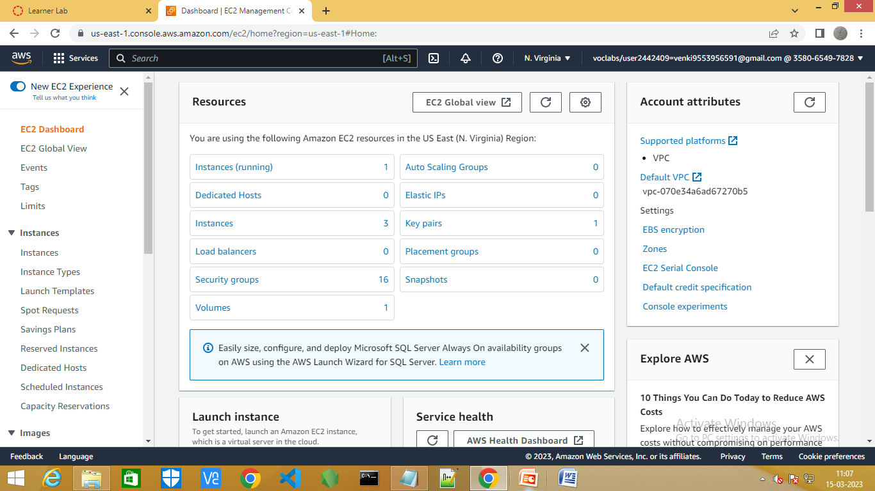
Step1:Go to the EC2 dashboard.

Slide 3
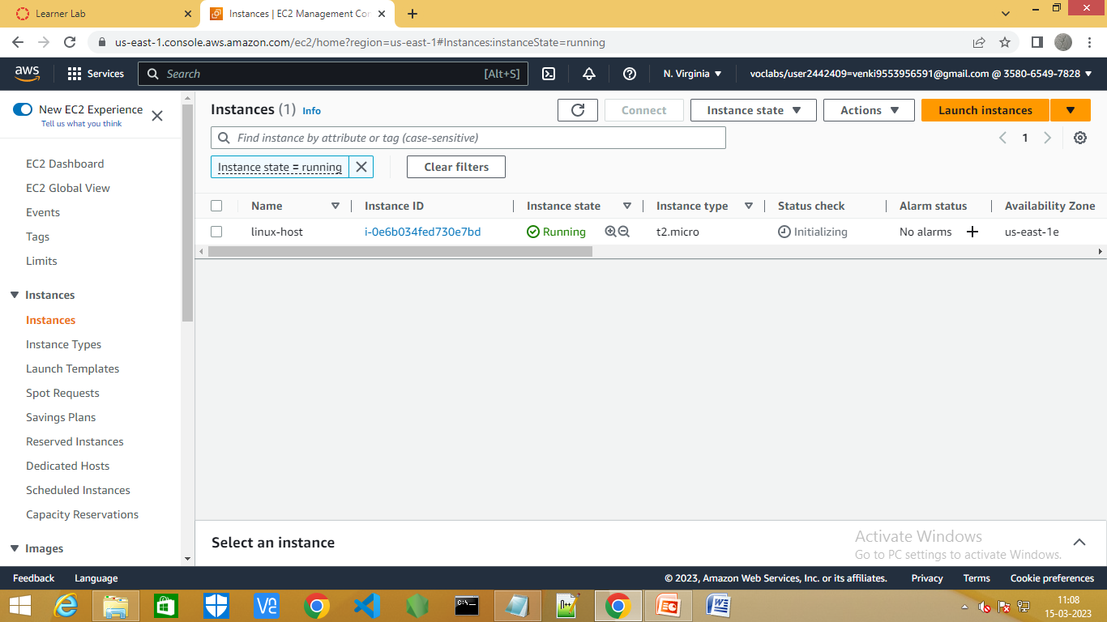
Step3:Create a new instance using Linux AMI .

Slide 4
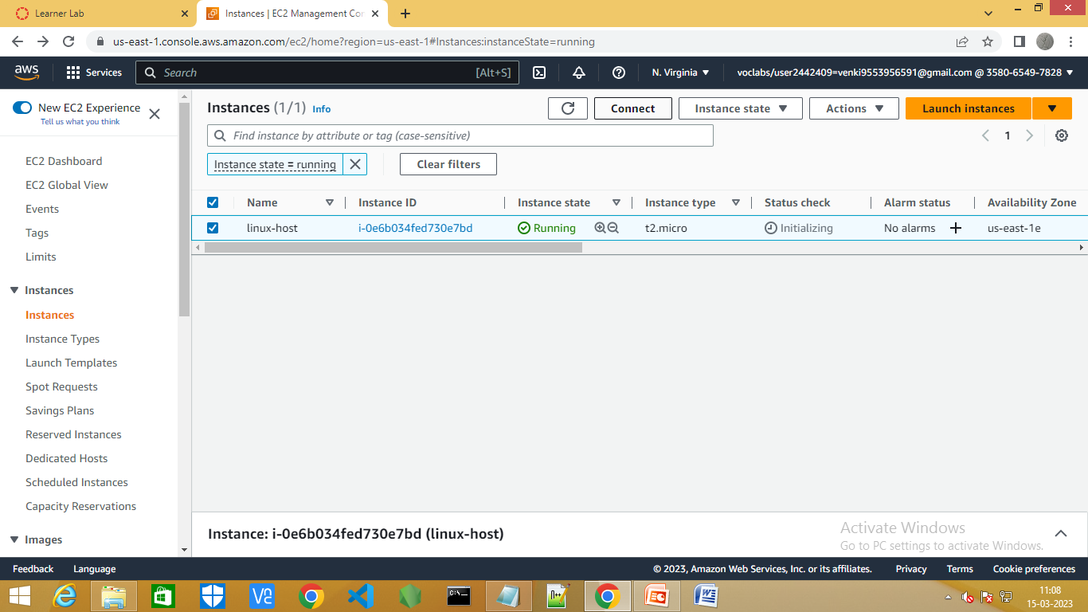
Step4:Click on linux-host and connect it.

Slide 5
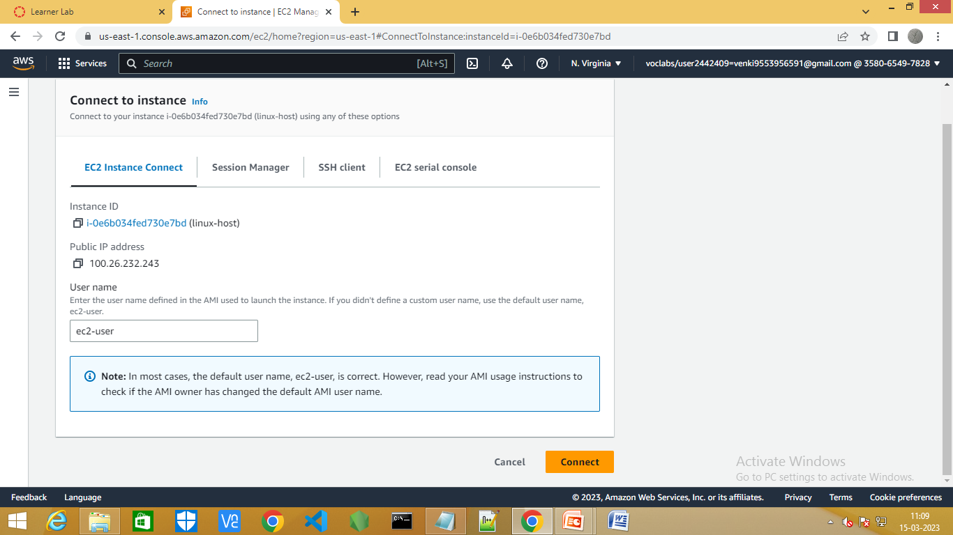
Step5:Select EC2 instance connect.

Slide 6
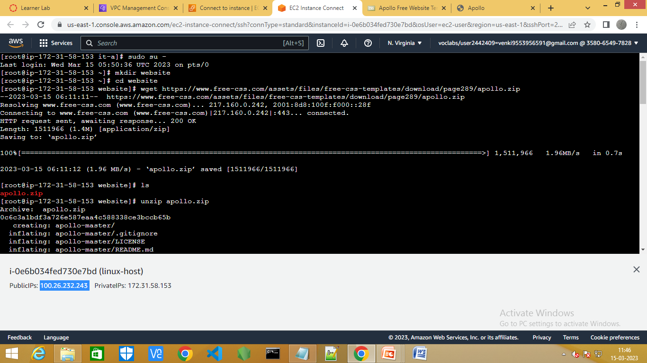
Step3:Run the commands as shown below.

Slide 7
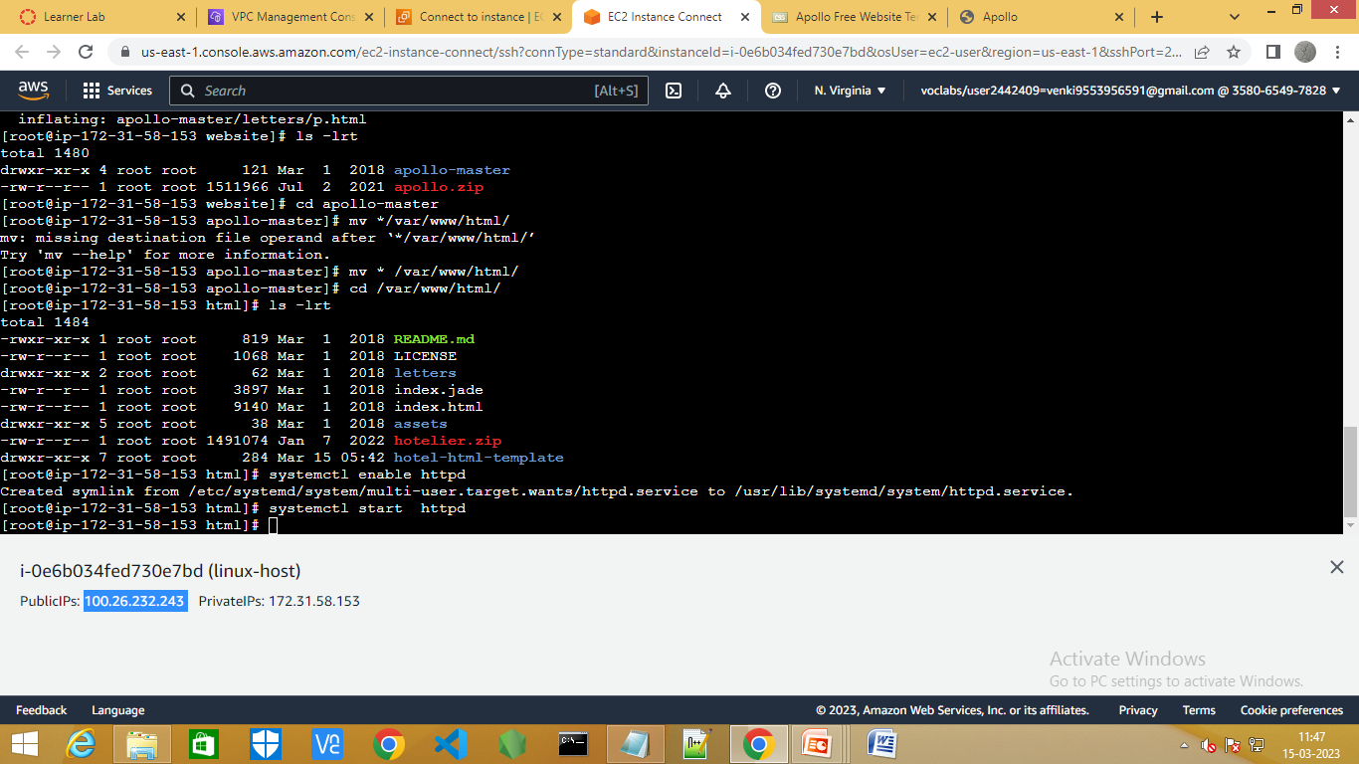
Step4:Run the commands as shown below.

Slide 8
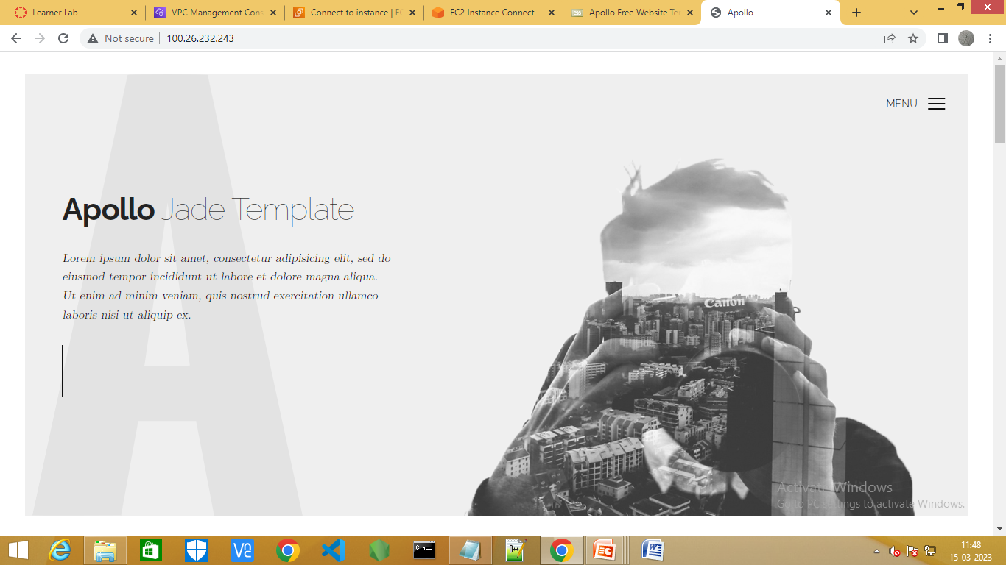
Step5:Copy the public ipv4 address and paste in new window.

